Slide 1
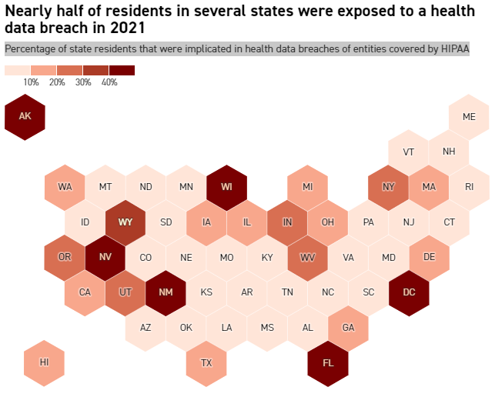
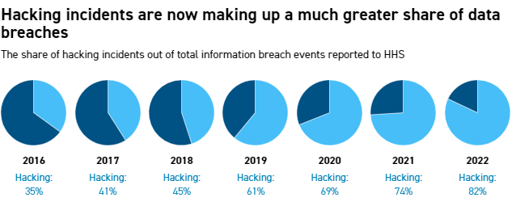
High profile data breach of 2021
“Unfortunately, the industry is pretty much easy pickings, and they’re hitting it because they’re getting paid,” said Mac McMillan, CEO of cybersecurity company CynergisTek. “It’s [not] gonna slow down until we either get more serious about stopping it, or blocking it, or being more effective at it. From the cybercriminals’ perspective, they’re being successful, they’re getting paid, why would they stop?”
In 2021 nearly 50 million people in the US had health data breached. Every state except South Dakota had reported about the incident. 1 in 10 people being directly affected was seen in half of the states.
Since 2016 hacking has increased to being accountable for 75% of breaches. Health care industries have rapidly moved to being digital especially during the pandemic. This leaves their systems more vulnerable to attacks since hacking has increased.
Significant security and privacy concerns because of the widespread unauthorised data access has caused losses of billions every year.
Healthcare data is targeted by hackers because it can be used for fraud or sold on the black market. It is said that an individual's health details can sometimes be worth more than a credit card.
IBM found that each data breach cost health care organizations an average of $9.23 million in 2021. The industry is also particularly vulnerable to ransomware because a potential disruption in care could threaten patients’ lives, leaving many health care organizations feeling forced to pay ransoms.

